Slide 1

RECIPE FINDER SYSTEM

Slide 2

TEAM INFORMATION:
Name | Roll no:
Dilshana Bano Sayyed | 221201
Abbas Ali Handia | 221218
Shadab Ali | 221217
By: SE Comps

Slide 3
INTRODUCTION:
Recipe Finder helps us to manage and search for cooking recipes. It has a options like adding a new recipe, enter instruction for a recipe ,searching for a recipe, and displaying all stored recipe details. We can add recipes with their names, ingredients, and instructions. When searching, it shows recipes that match our keywords. It's a simple, text-based tool to keep and find our favorite recipes.

Slide 4
Flow of the site:
Recipe Finder
Enter Recipe
Name
Enter Recipe
To find
Enter Instructions
Display Recipe
Rate
Review
Nutritional content
Recipe of the
Day.
Quit

Slide 5

Technology and functions used:
The website is based on java:
we have used class ,objects ,methods ,inheritance ,constructors , looping , switch statements ,Array list ,Scanner etc, Inorder to implement the website.

Slide 6
Functionality :
)Adding Recipes: we can add a new recipe by entering its name, ingredients, and instructions.
)Searching Recipes: we can find recipes that contain specific words or ingredients by typing a name, and it displays matching recipes .If the recipe is not in the list it shows invalid recipe.
3.)Enter instructions: we can add a list of all the instructions like ingredients etc.
4.)Quit : It have a quit option as well ,after adding recipe user can quit and easily access the recipe
5.)Storing Data: The program stores our recipes so we can access them later.
6.)other detailing: It also contain options like nutritional information ,rating ,review.

Slide 7
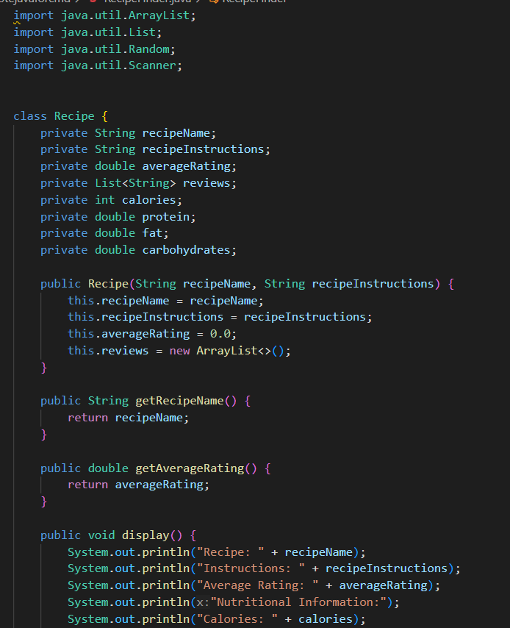
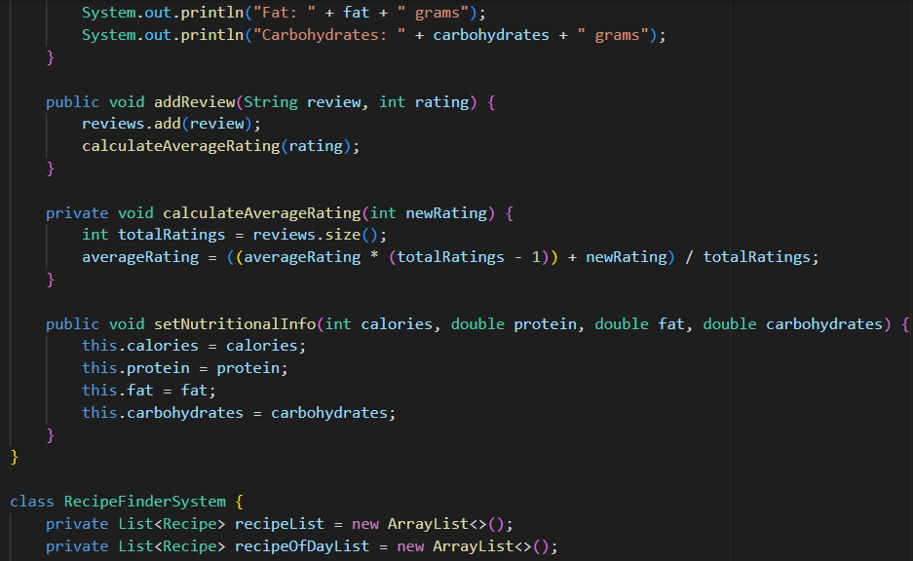
Sample Input :

Slide 8
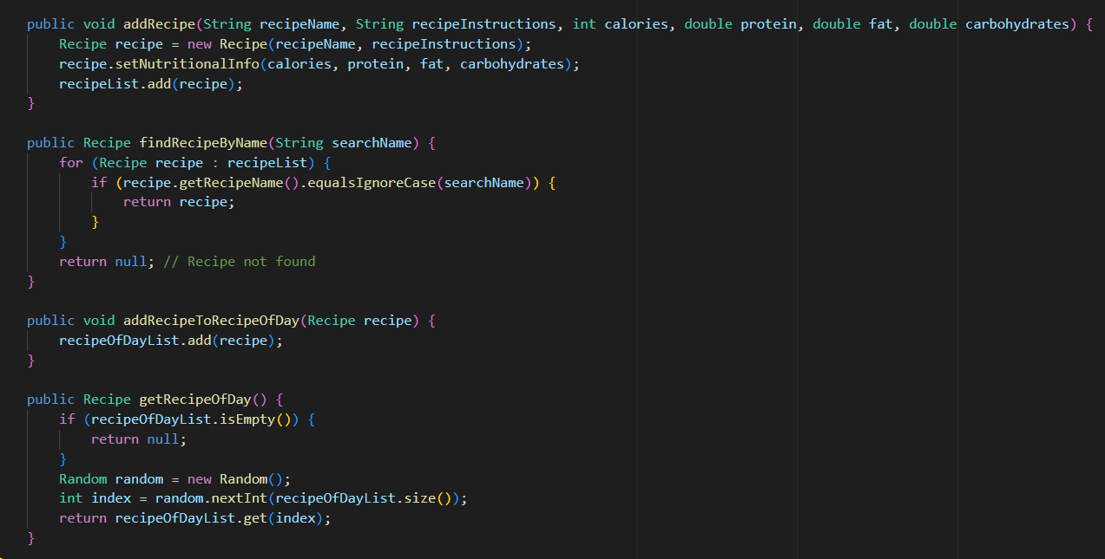
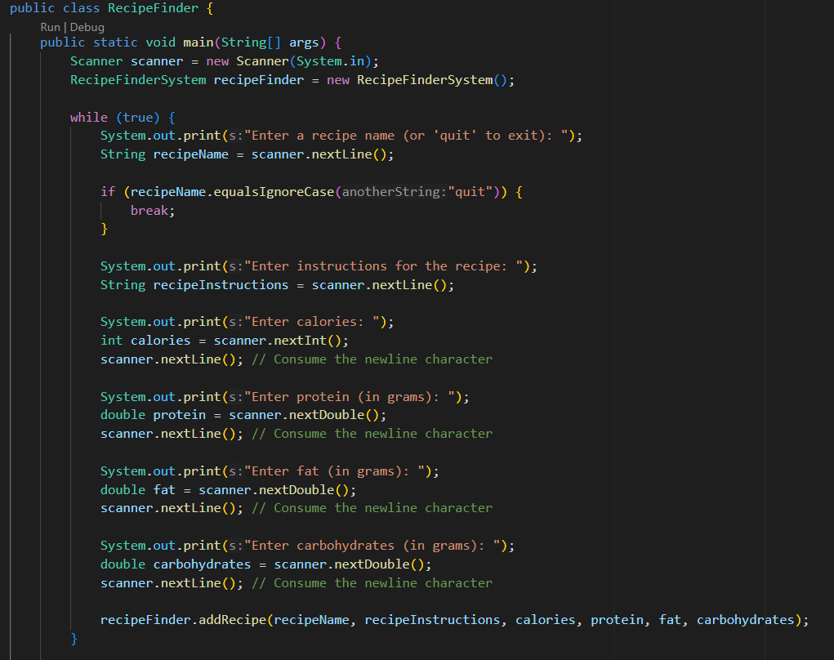

Slide 9
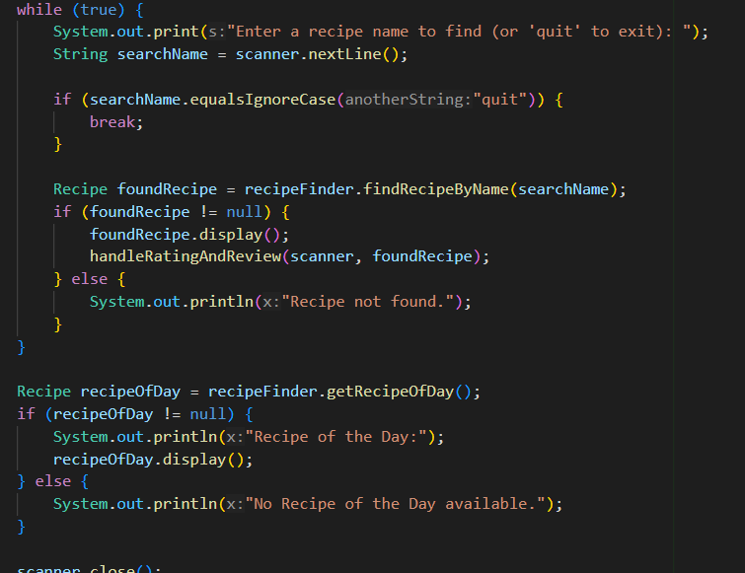
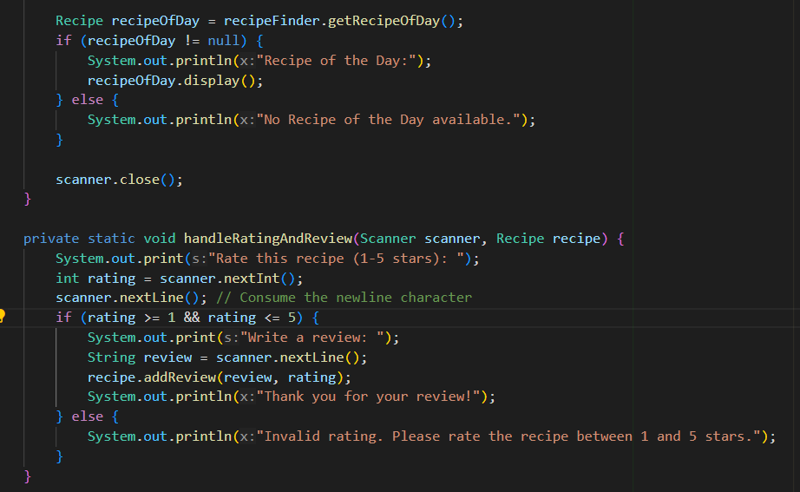

Slide 10
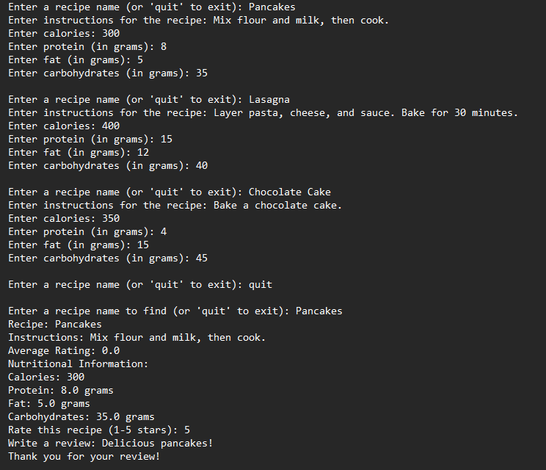
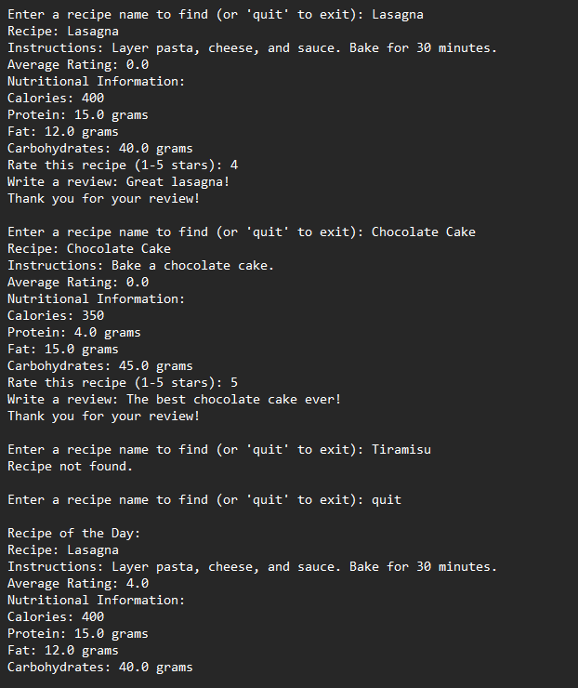
sample output:

Slide 11
Conclusion:
The Recipe Finder program offers a versatile platform for managing and exploring a diverse range of recipes. It empowers users to contribute, discover, and engage with culinary creations in an interactive and user-friendly environment. Key features, including recipe addition, nutritional information, and the "Recipe of the Day," cater to a wide audience and promote culinary exploration. Furthermore, it encourages user engagement through rating and reviews, creating a vibrant recipe-sharing community. The project holds significant potential for future enhancements, such as user profiles and expanded nutritional analysis capabilities, making it a valuable learning experience for Java programming and user-centric interface design.

Slide 12
Thank
you

